Slide 1
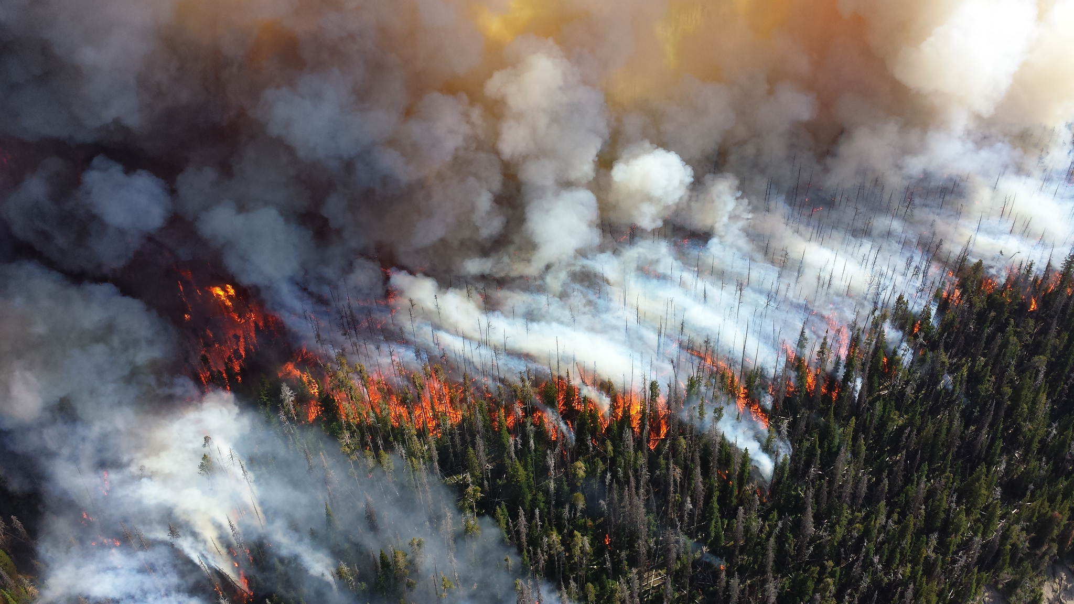
Glacier Theory
Foo Lin Geng
Tong Hui Kang

Slide 2
Problem
Context: Glacier National Park (hikers / campers)
Many campsites in the park are accessible only on foot
Little cell coverage in the park
Prohibited use of wheeled or motorized vehicles in back-country
Objective
Propose an evacuation plan for each of the park regions in the event of a forest fire.

Slide 3
Assumptions
Rescue teams can only be dispatched from backcountry permit offices.
Hikers only need a notification, and do not need a ranger to escort them back to safety.
Back-country campers are to hike to a location where they can be transported by bus to safety.
For our current models, campers and rangers will not be “trapped”.

Slide 4

Modelling
Fire spreading rate (m/min):
$${baseRate}^{\left(\frac{windSpeed}{25.56487} + \frac{\sin\left(slopeAngle\right)}{14.2831}\right)}∗windSpeed+0.122533$$
Path evaluation
$$\sum_{campgrounds}^{ }{exp\left(\frac{2}{{t_{arrival}}_{fire}−t_{arrival_{ranger}}−2 hours}\right)}$$

Slide 5
Tuning the Model of fire-spreading rate
Compared our model to the Rothermal package

Slide 6
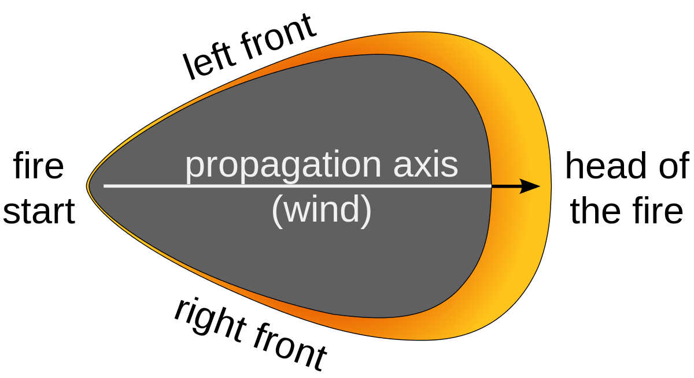
Conical Stochastic fire spreading model
Used a stochastic model to make the fire be conically shaped, which is the simplest shape of wildfires

Slide 7
Path Evaluation Demo

Slide 8
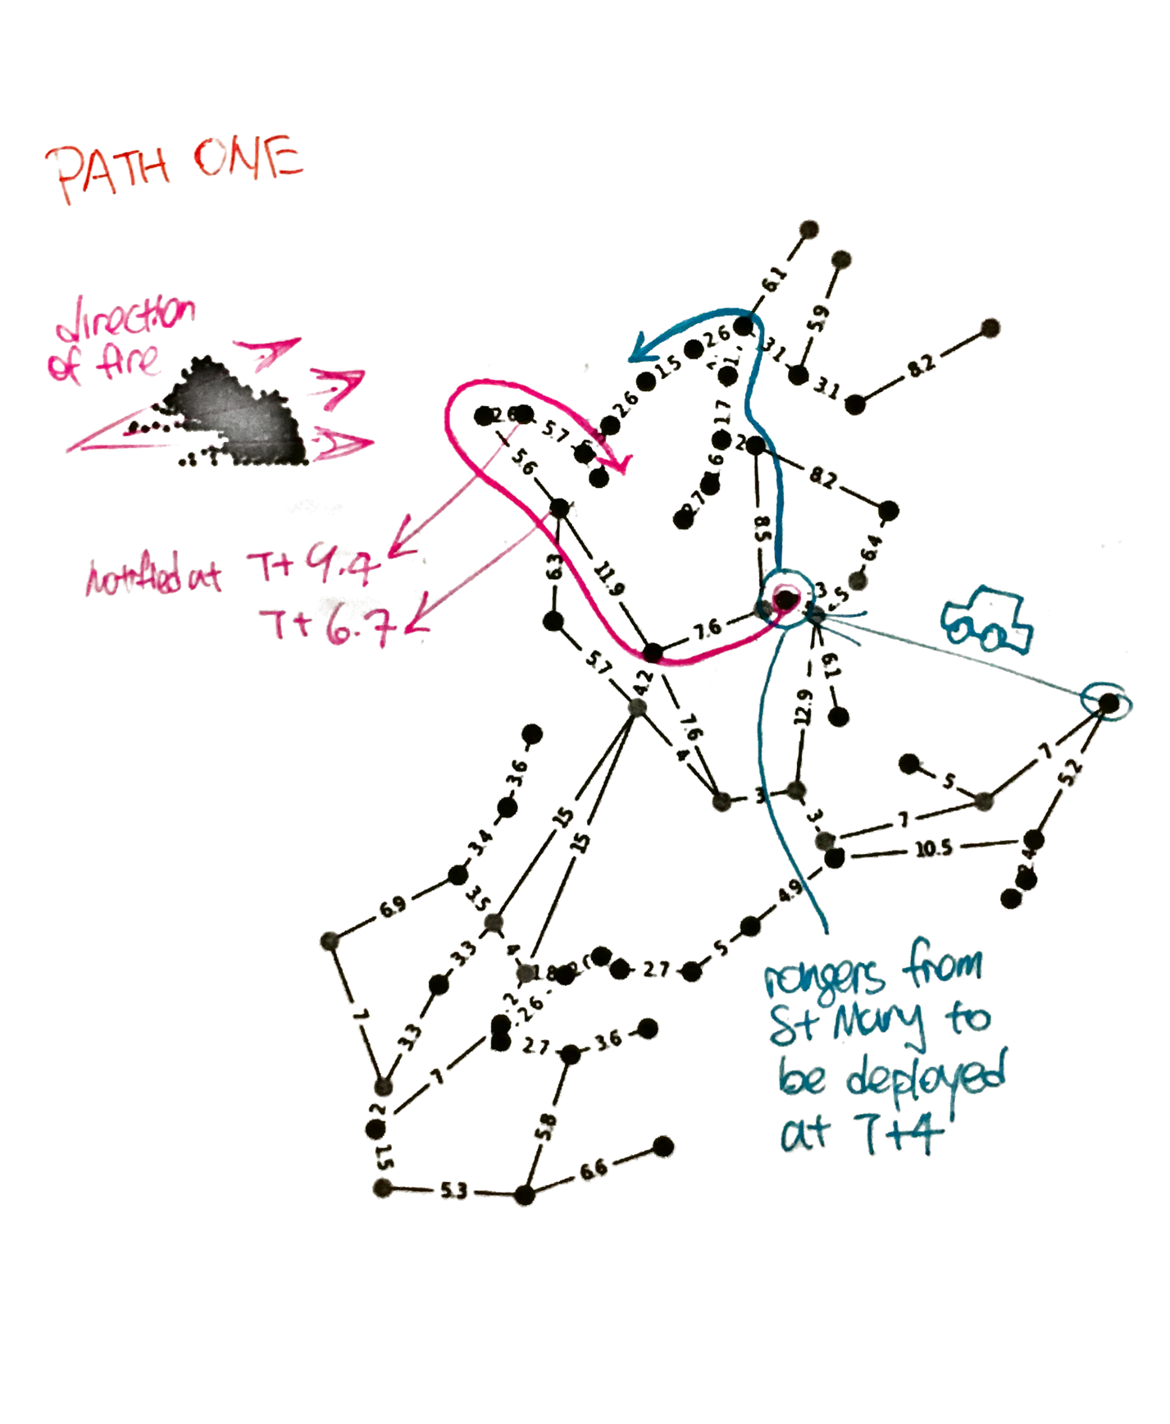
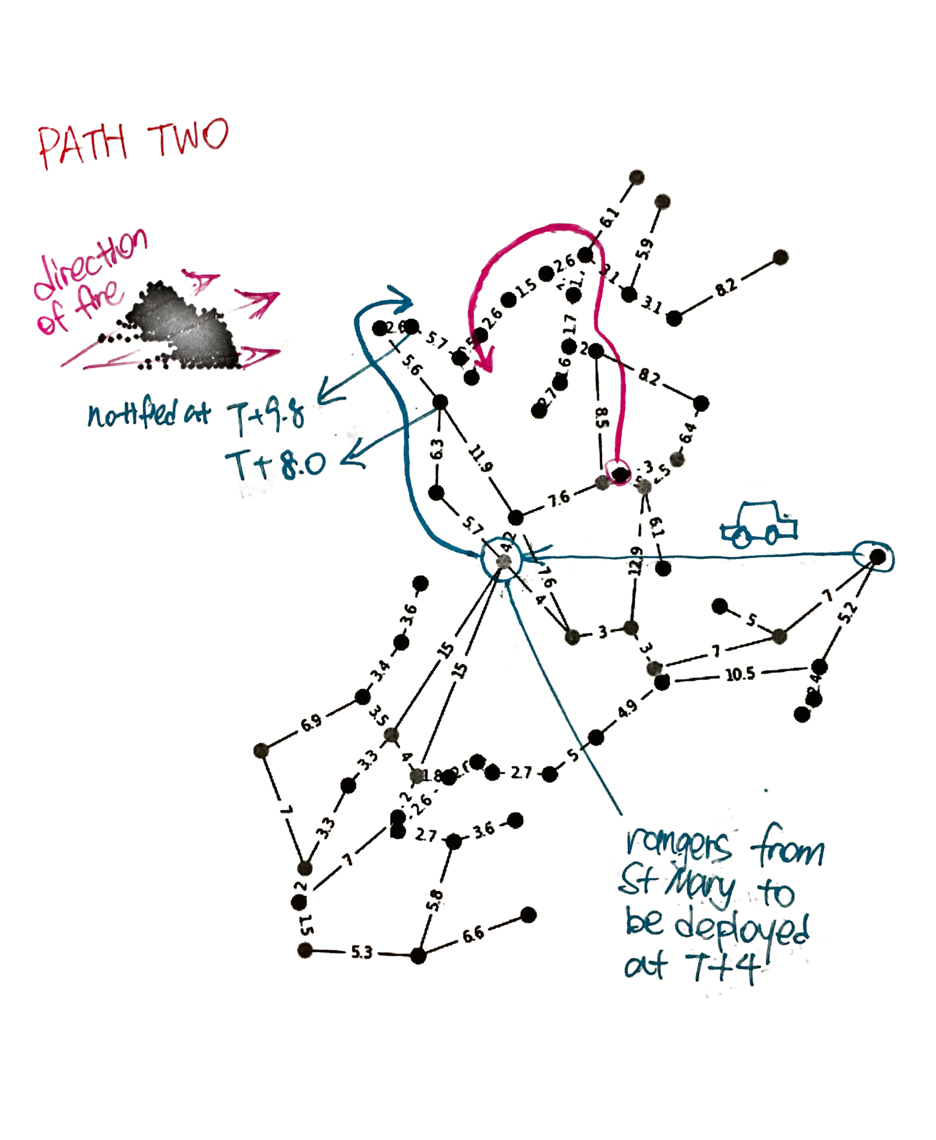

Slide 9
Q&A

